Slide 1

Department of Computer Science Gujarat University
5 Year Integrated M.Sc.(Computer Science)
Semester - V
Shop Zone
Presented By:
Aasima Mansuri(50035)
Khushi Shah(50083)
Krisa shah(50084)
Jinal Vachheta(50104)
Under the Guidance of :
Dr. Jigna Satani

Slide 2
Table of Content
Project Profile
Project Description
Introduction
Scope
Methodology
System Architecture
System Design(Diagrams)
DFD & ER
Or
Use Case,Activity,Sequence,class
Data Dictionary
Screenshots
Testing and Conclusions
Future Work
Bibliography

Slide 3
Project Profile
Name Of The Project | Shop Zone
Aim | Making an Online Store for All Your Fashion Needs
Tools, Technology and framework | HTML ,CSS ,MYSQL , Bootstrap, JSP , JDBC, Servlet
Duration | ( 6 months)
Minimum software and hardware requirements | Windows Operating System, Internet Connection RAM: 4GB Browser
Team size | 4 members
Team members | Mansuri Aasima (50035) Shah Khushi (50083) Shah Krisa (50084) Vachheta Jinal (50104)

Slide 4
Project Description
Introduction
Shop Zone is dedicated to offering a wide range of high-quality clothes for men, women, and children. Our goal is to provide a convenient, user-friendly, and enjoyable shopping experience for everyone.
Key features:
Product sorting by category , discount, color, and price.
User-friendly account registration and login.
Shopping cart management and order placement.
We offer a secure payment option with Cash on Delivery
Role-based access for Customers, Admins, and Delivery Person.

Slide 5
Project Description
Scope
Shop Zone is a simple platform where customers can easily browse, filter, and buy fashion products. It allows users to register, manage their cart and place orders. Admins manage products and orders, while delivery person update delivery details. In the future, we will include improved payment options and order tracking.

Slide 6
Project Description
Methodology
Requirement Gathering: Identifying features like product browsing, account management, and order processing.
System Design: Creating diagrams to plan the system's structure and workflow.
Development: Building the platform using HTML, CSS, JSP, JDBC, Servlets , Bootstrap, and MySQL.
Testing: Ensuring functionality, usability, and security.
Future Enhancements: Planning upgrades like better payment options and real-time tracking.

Slide 7
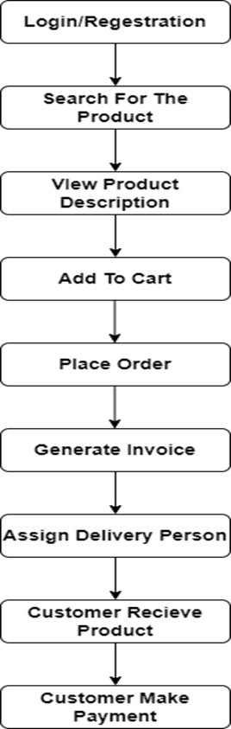
Flow of System

Slide 8
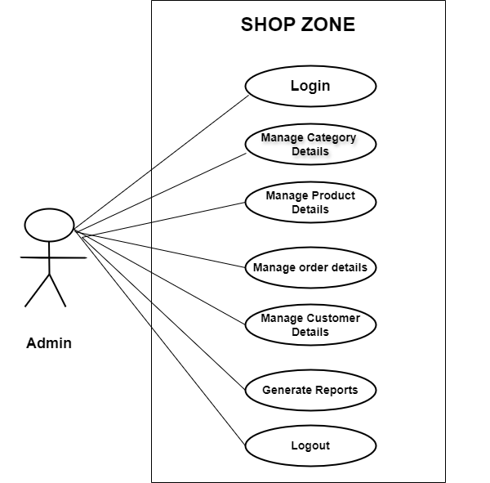
System Architecture
Use case diagram

Slide 9
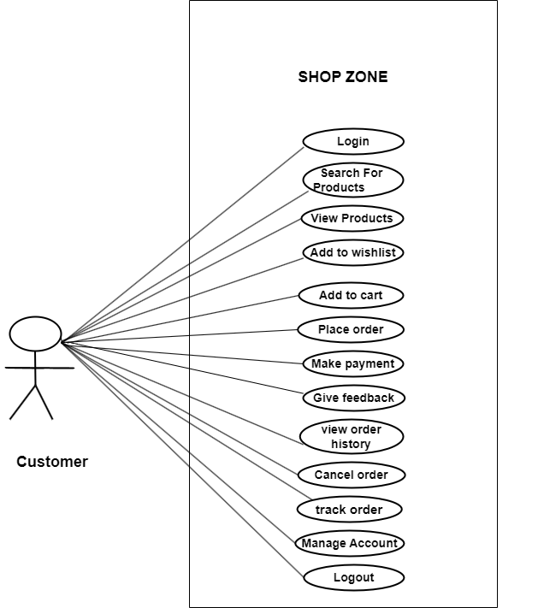
use case diagram of customer

Slide 10
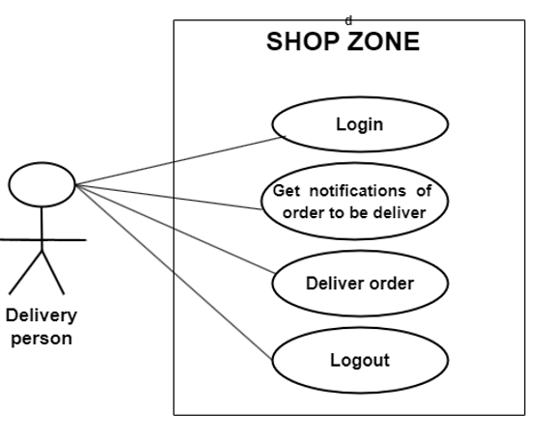
use case diagram of delivery person

Slide 11
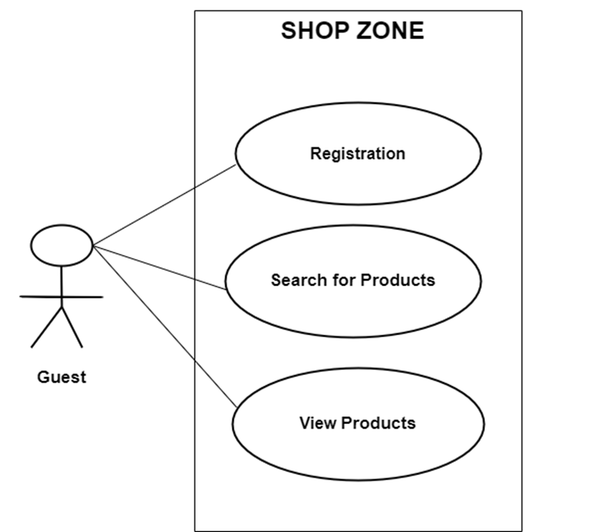
use case diagram of guest

Slide 12
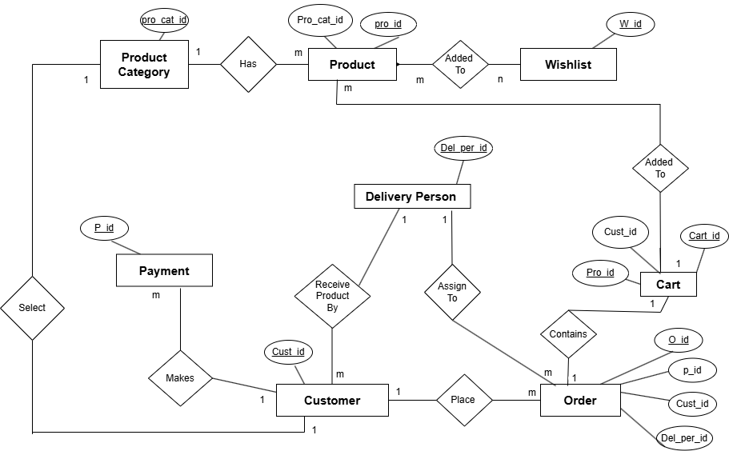
System Design
ER diagram

Slide 13
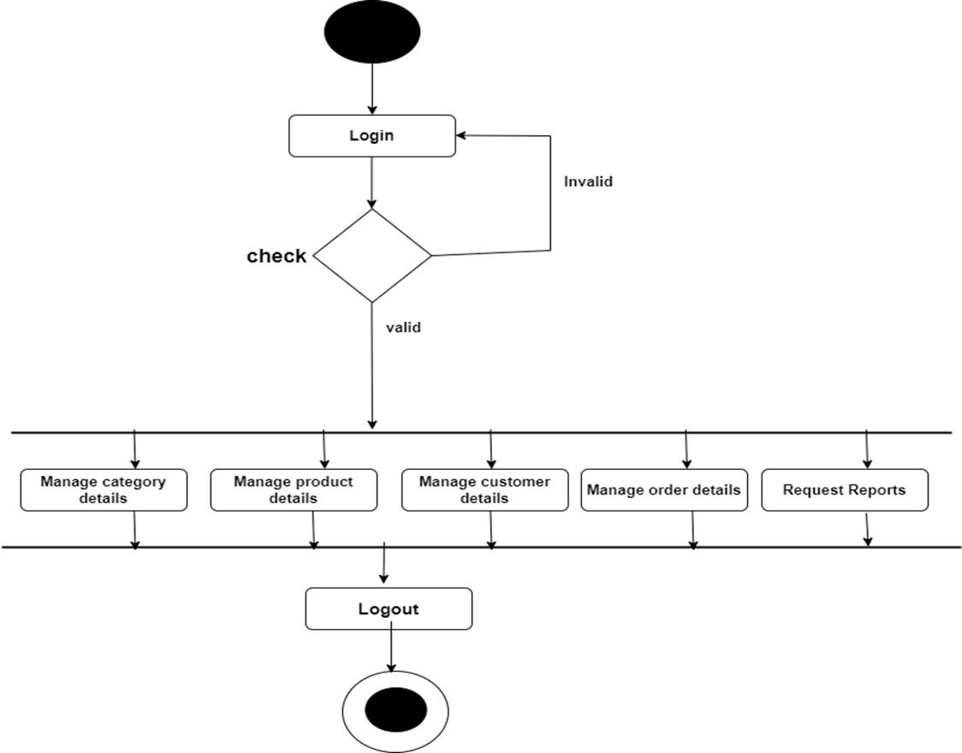
Activity diagrams
Activity diagram of admin

Slide 14
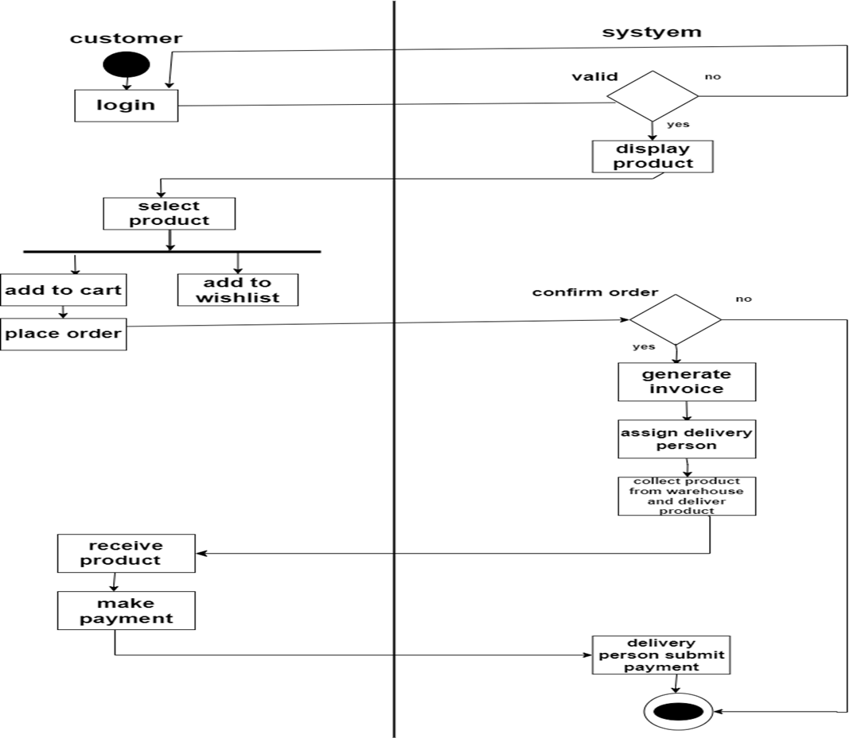
Activity Diagram of User(customer , system)

Slide 15
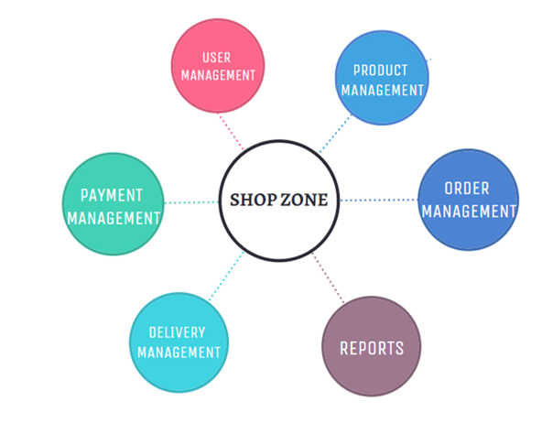
Module hierarchy

Slide 16
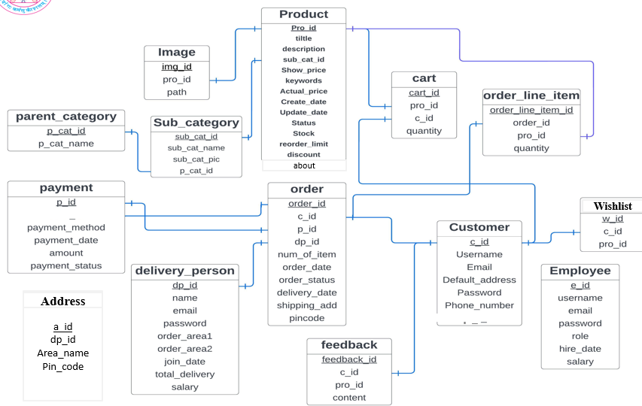
Data Dictionary
upi_id

Slide 17
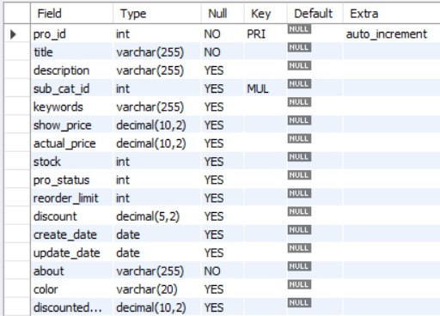
Product table

Slide 18
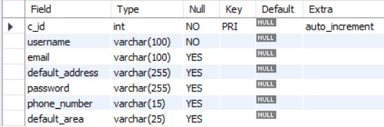
Customer table

Slide 19
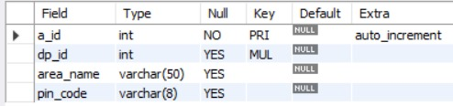
Address table

Slide 20
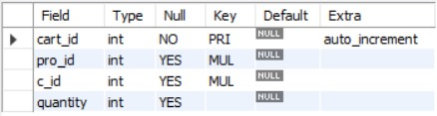
Cart table

Slide 21
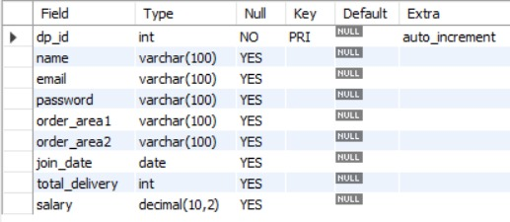
Delivery person table

Slide 22
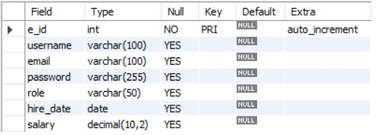
Employee table

Slide 23
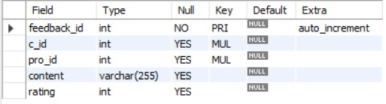
Feedback table

Slide 24
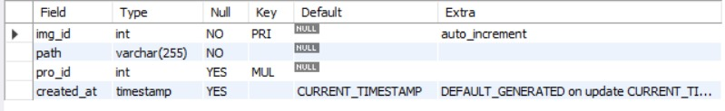
Image table

Slide 25
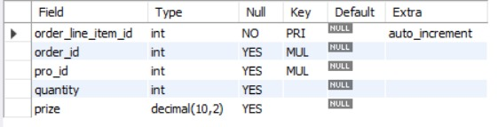
Order line-item table

Slide 26
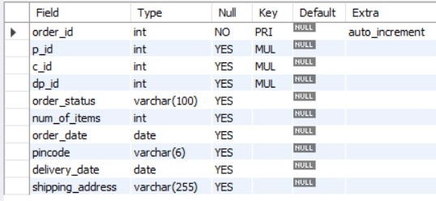
Order table

Slide 27
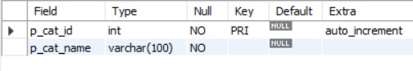
Parent Category table

Slide 28
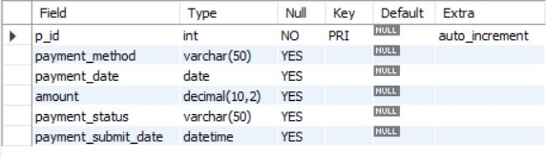
Payment table

Slide 29
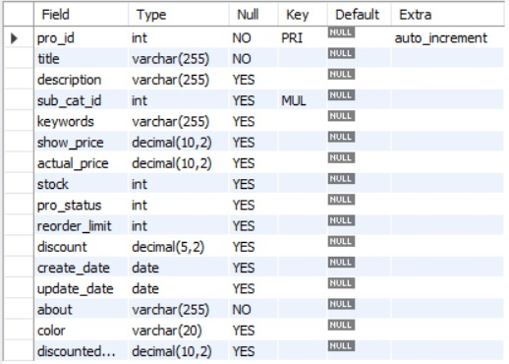
Sub category table

Slide 30
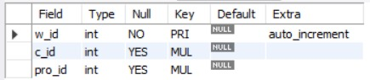
Wishlist table

Slide 31
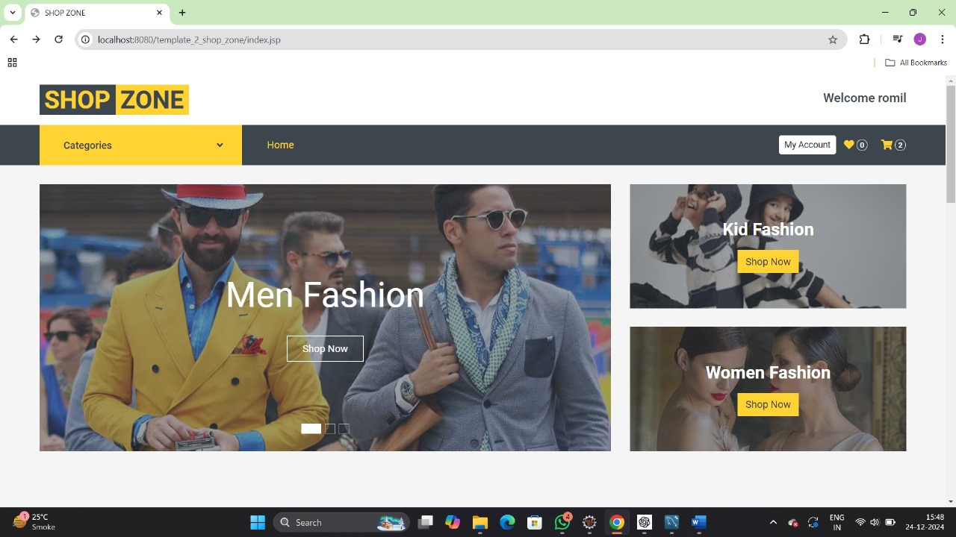
Home Page

Slide 32
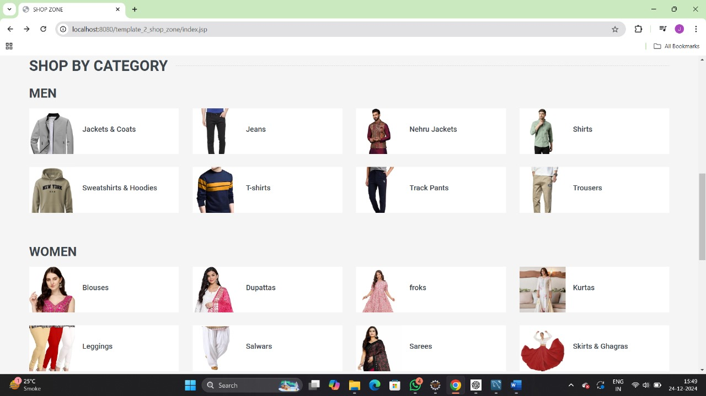
Home Page

Slide 33
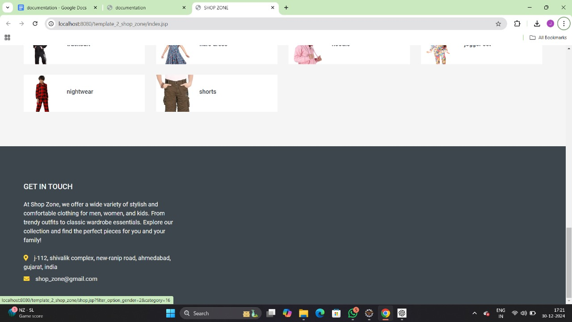
Home Page

Slide 34
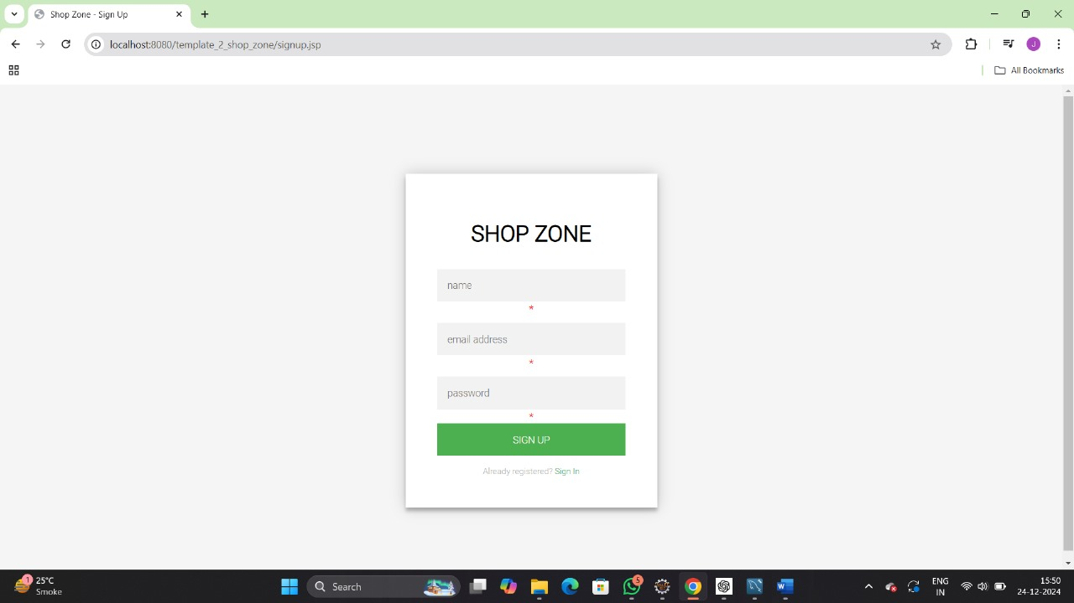
Sign UP Page

Slide 35
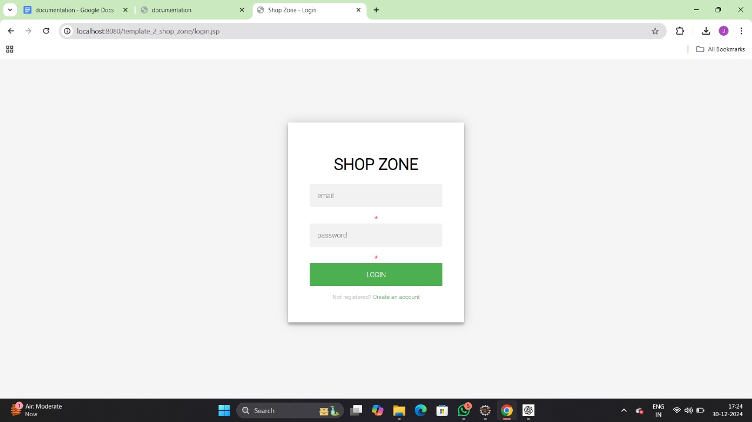
Login Page

Slide 36
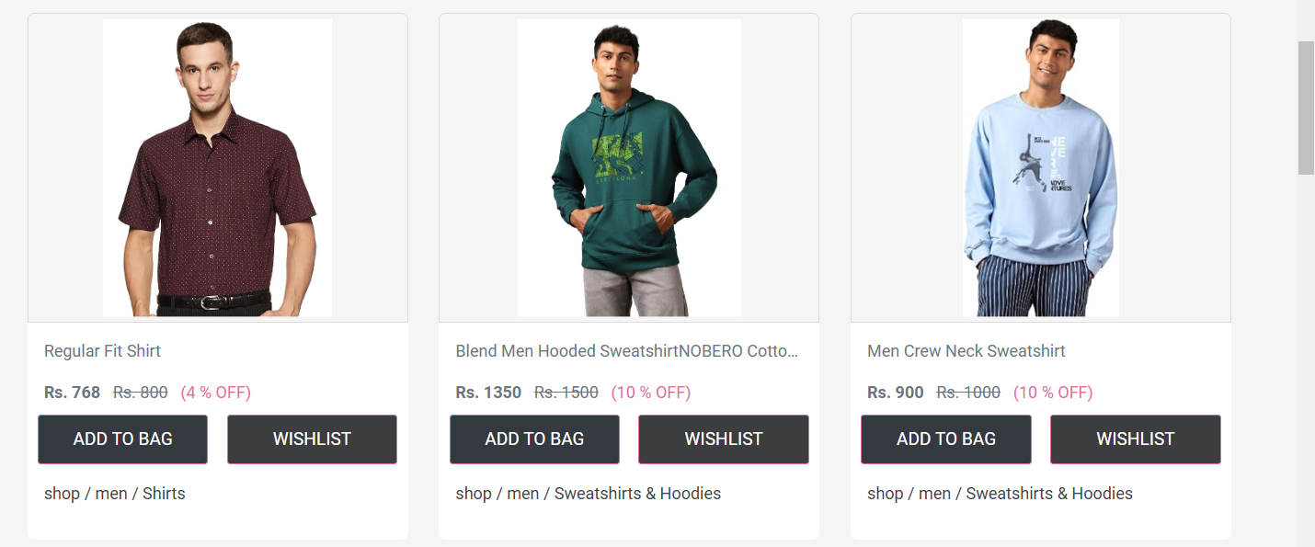
Shop Page

Slide 37
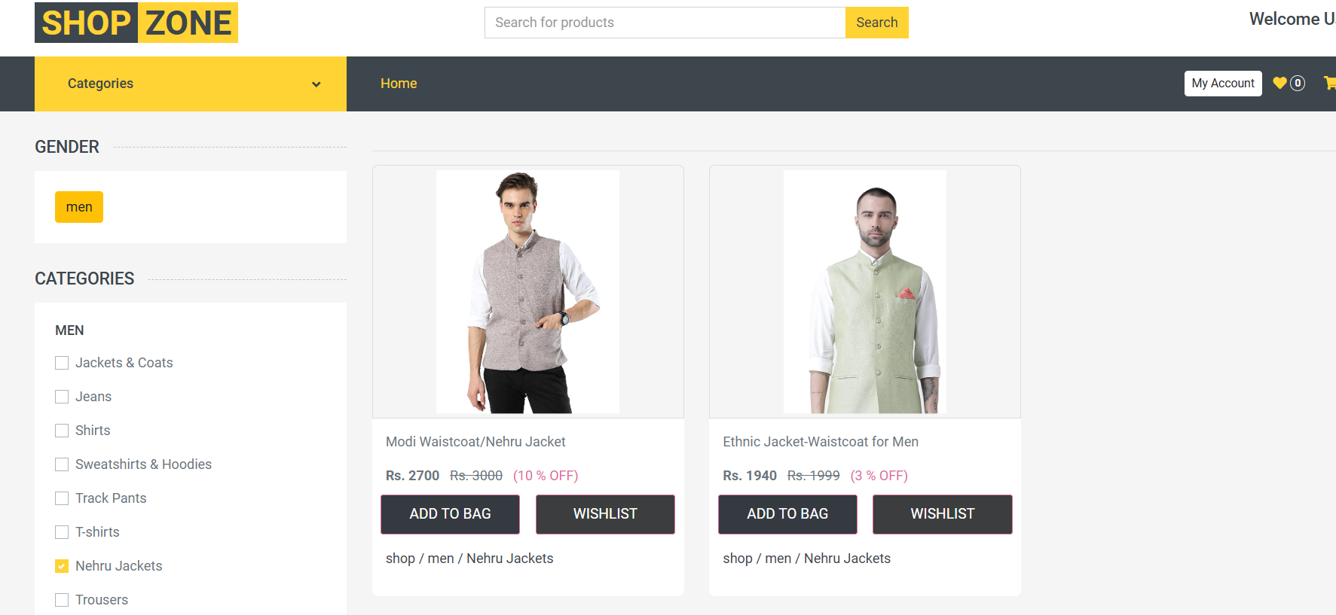
Shop Page

Slide 38
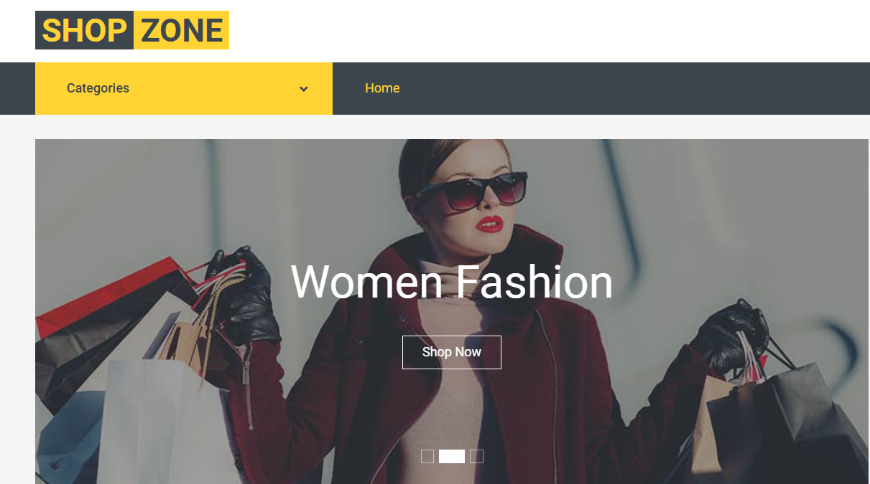
Shop Page

Slide 39
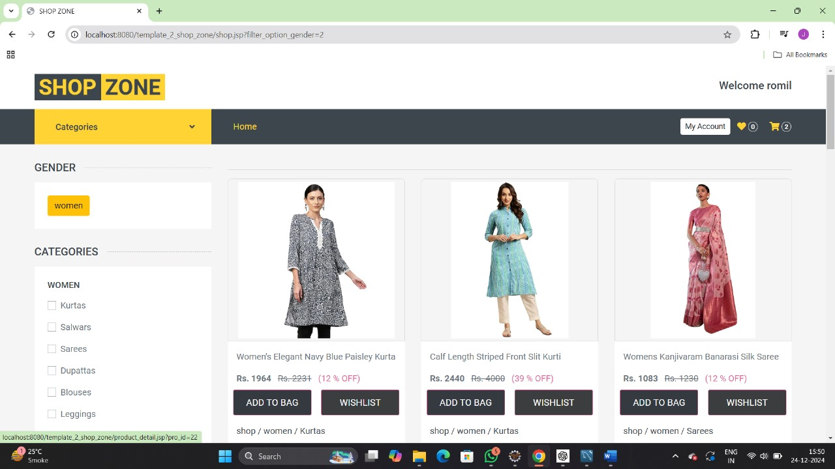
Shop Page

Slide 40
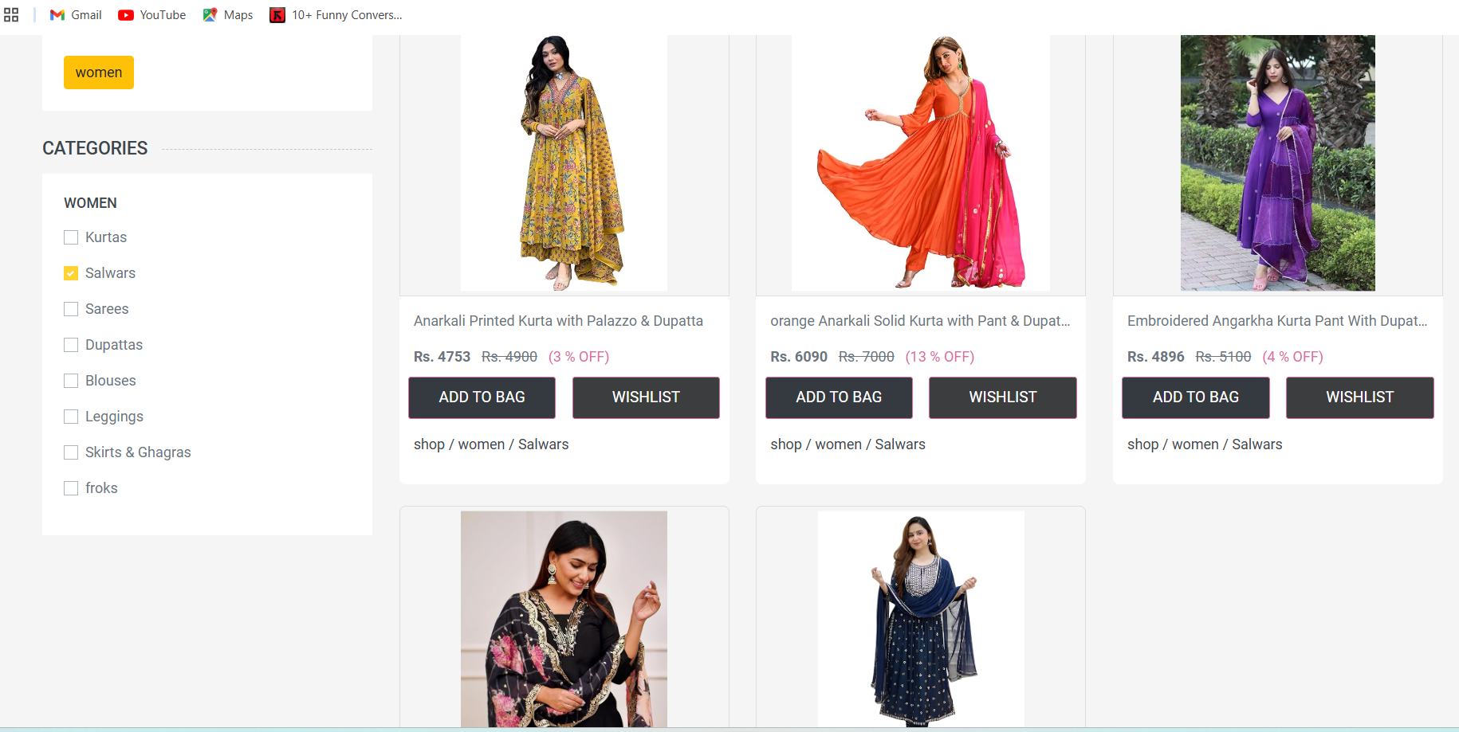
Shop Page

Slide 41
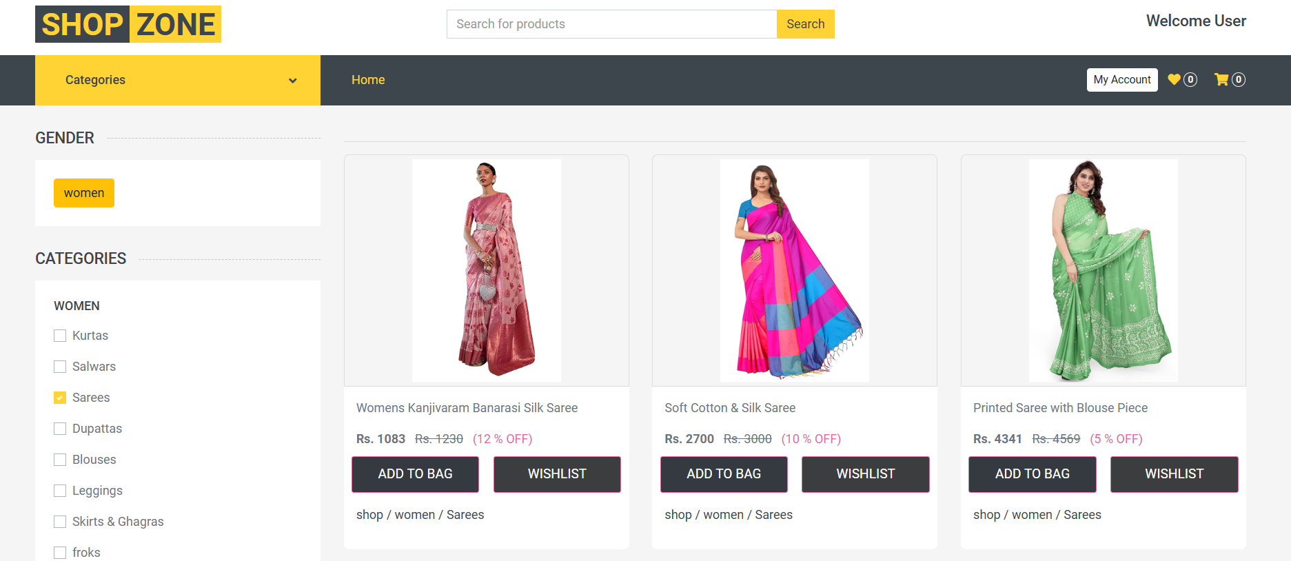
Shop Page

Slide 42
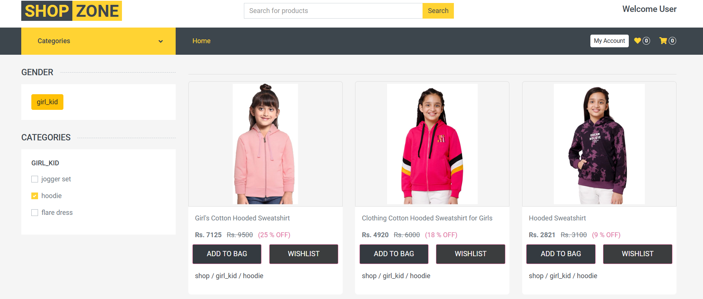
Shop Page

Slide 43
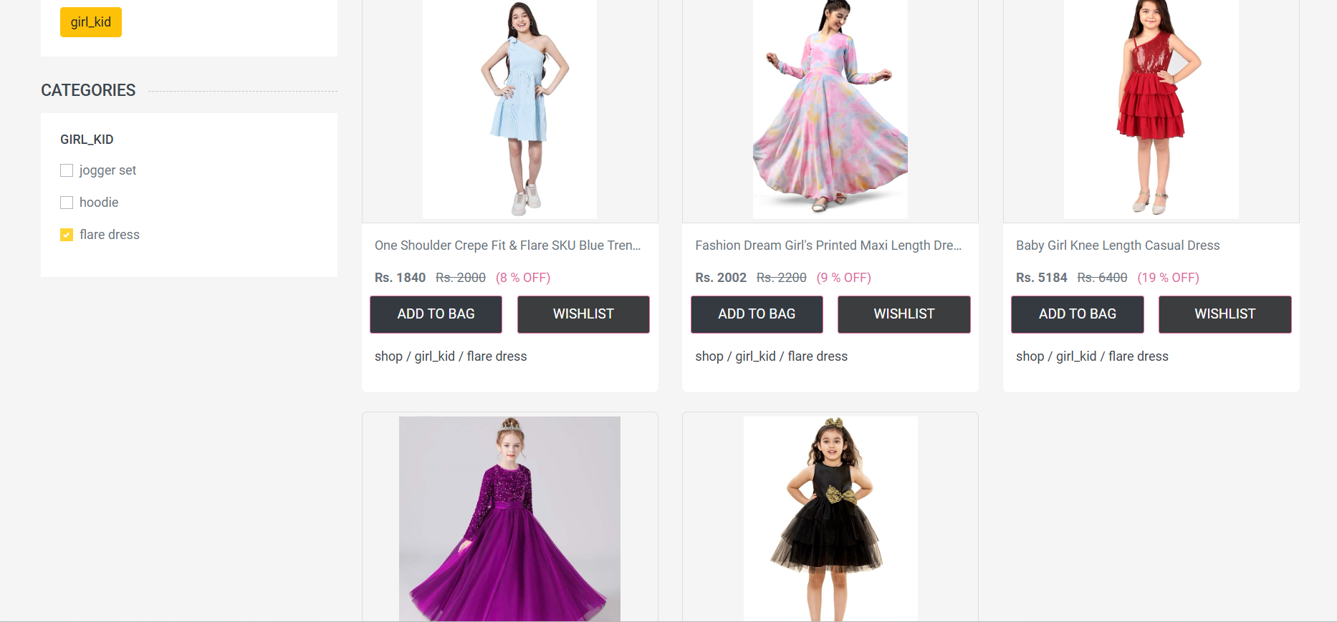
Shop Page

Slide 44
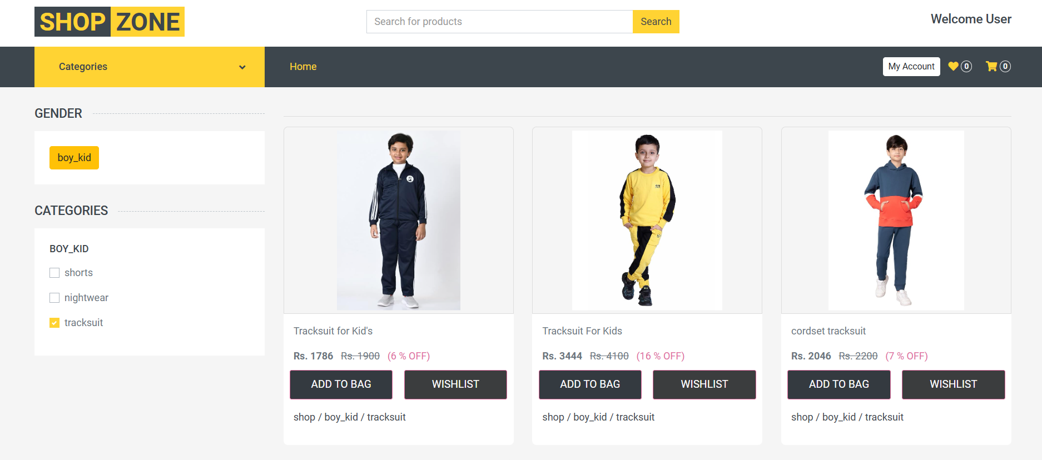
Shop Page

Slide 45
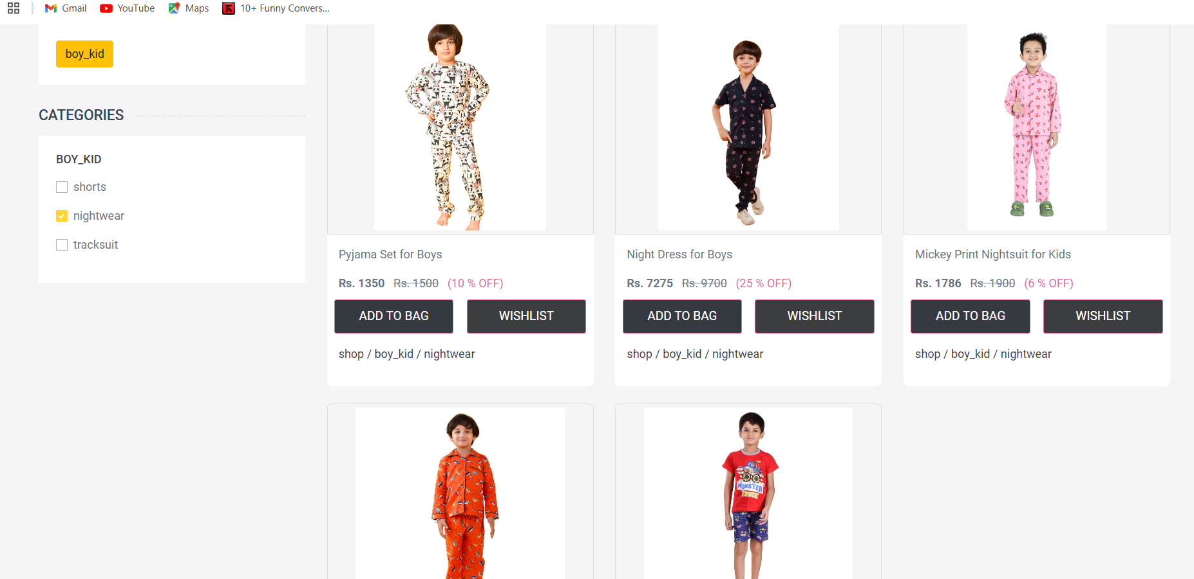
Shop Page

Slide 46
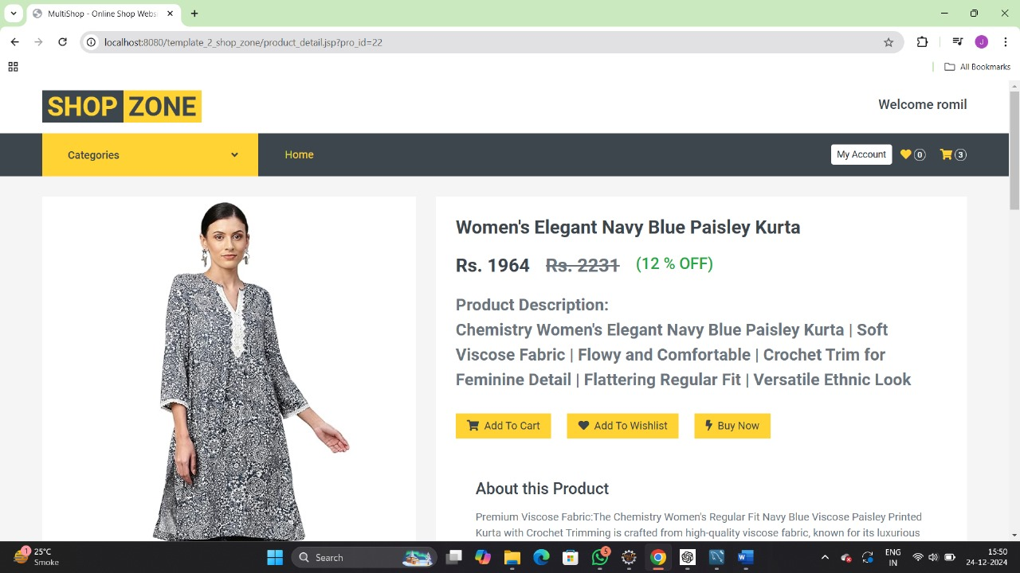
Product Detail Page

Slide 47
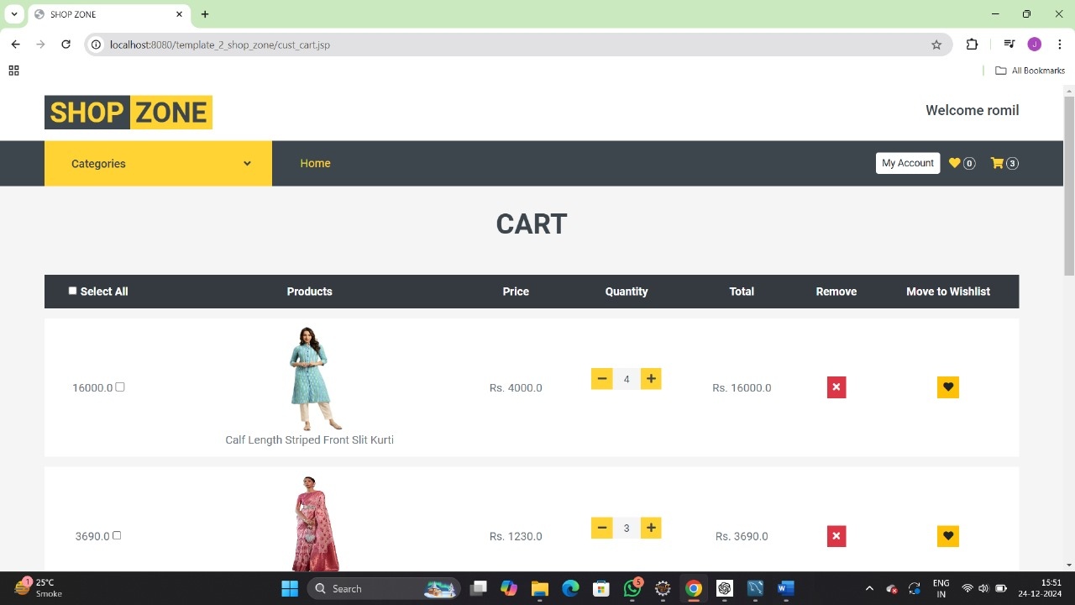
Cart

Slide 48
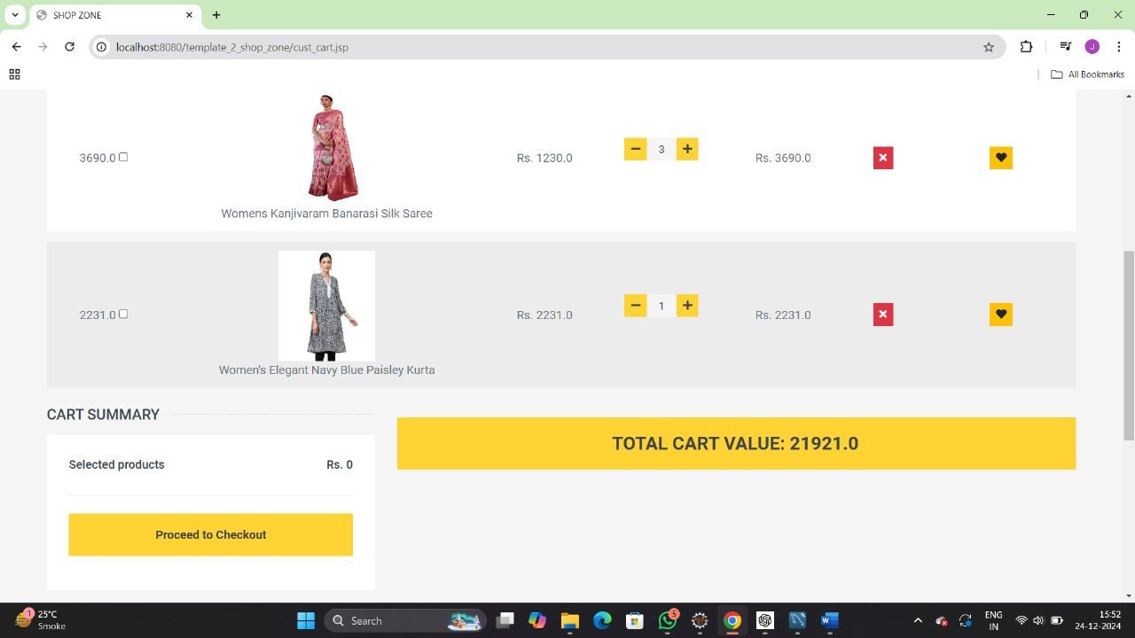
Cart

Slide 49
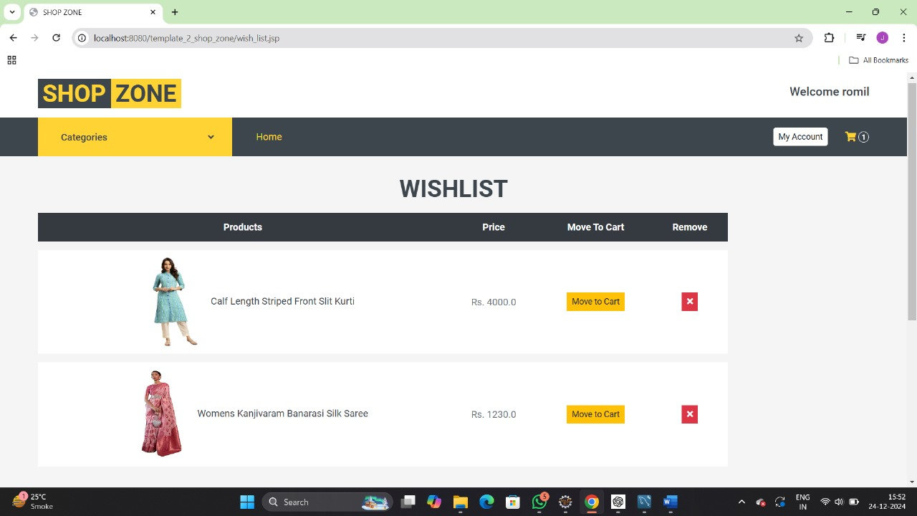
Wish list

Slide 50
Product Detail Page

Slide 51
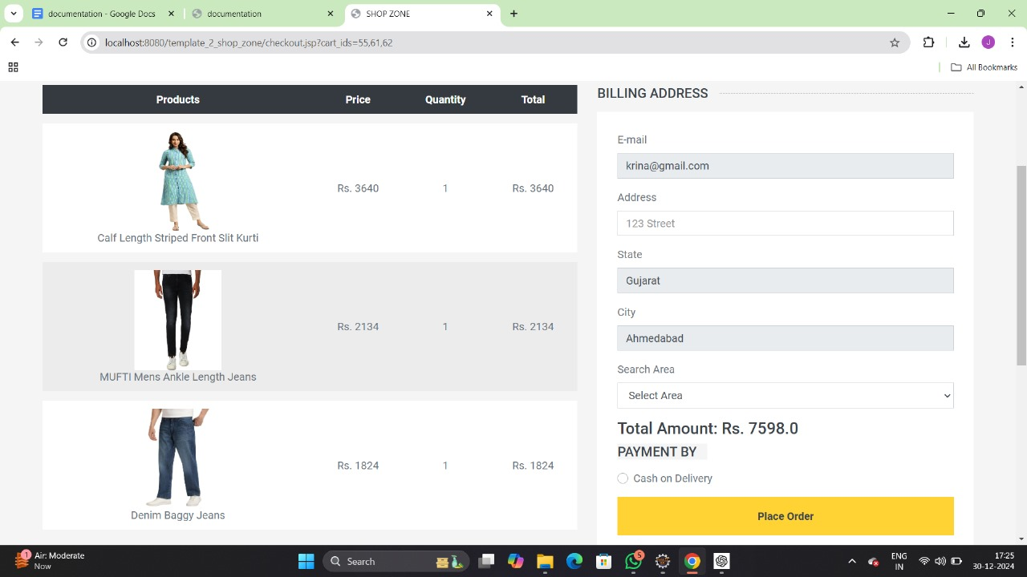
Check out Page

Slide 52
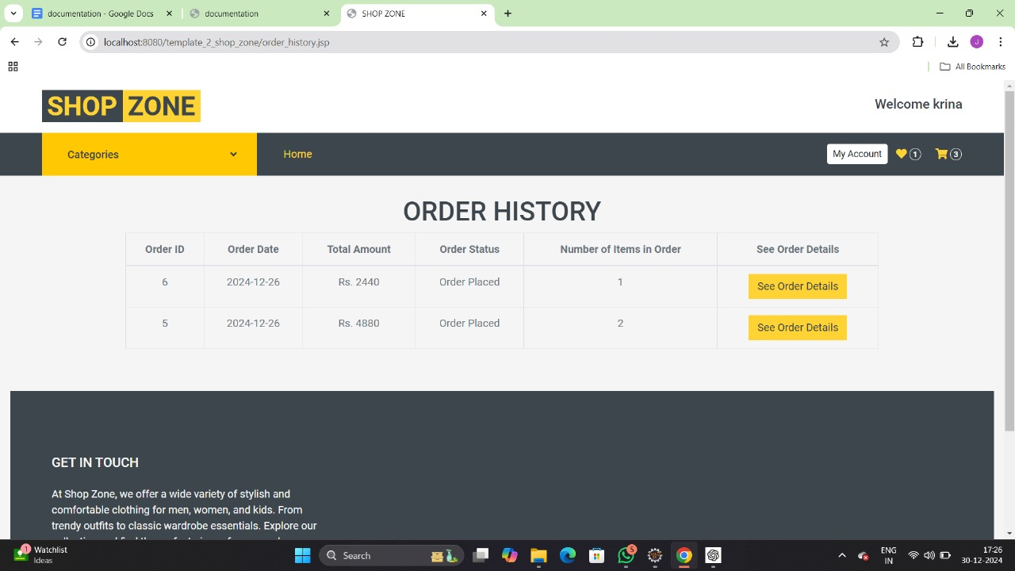
Order History Page

Slide 53
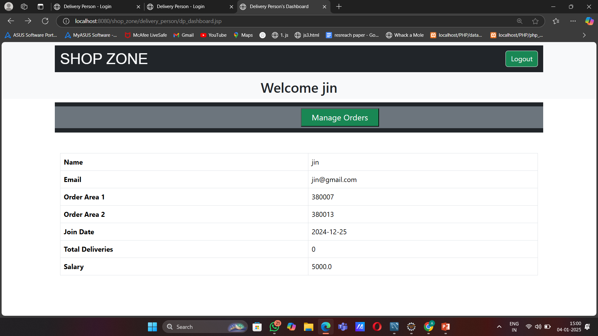
Deliver Person Dashboard

Slide 54
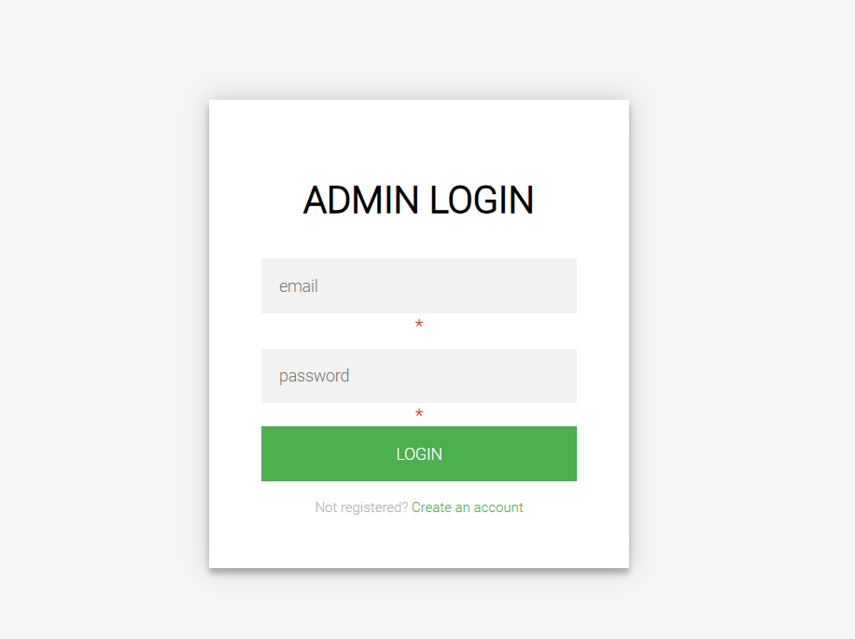
Admin Dashboard

Slide 55
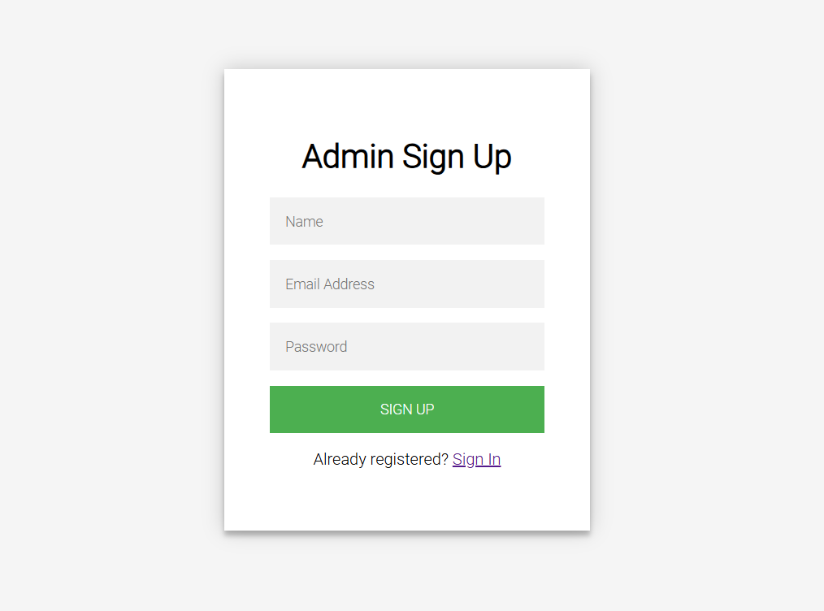
Admin Dashboard

Slide 56
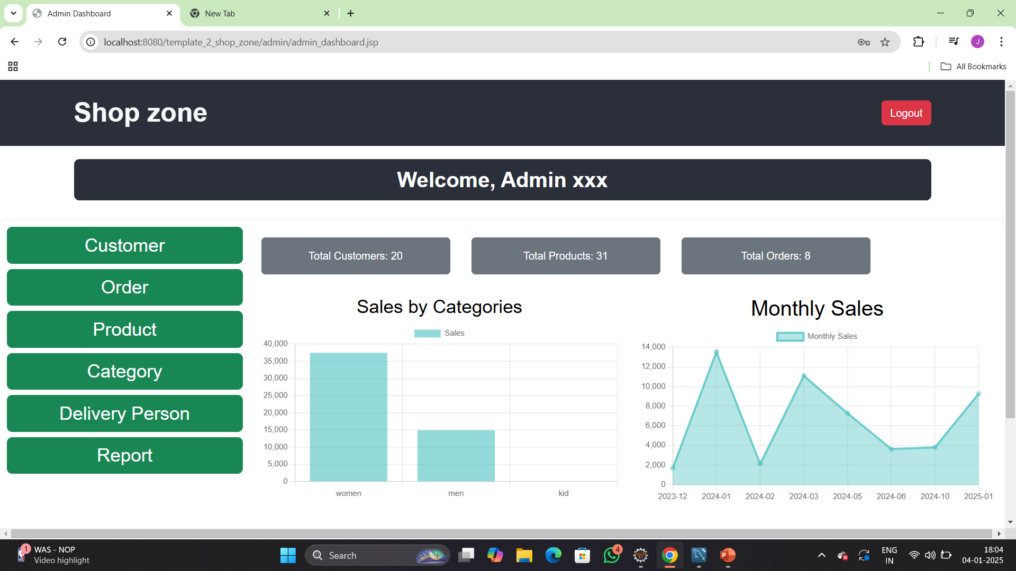
Admin Dashboard

Slide 57
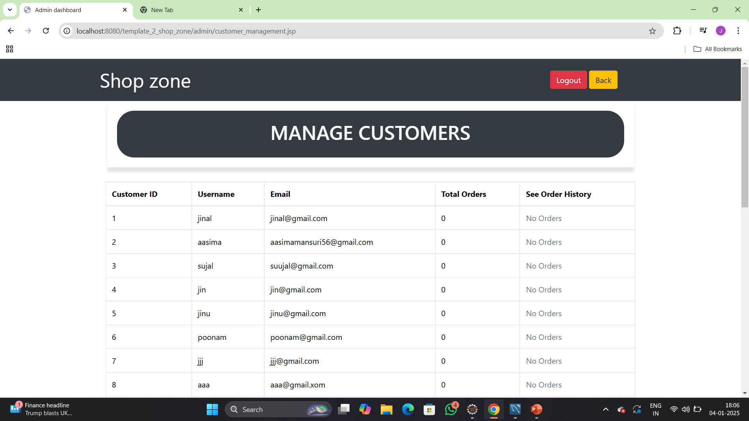
Admin Dashboard

Slide 58

Admin Dashboard

Slide 59

Admin Dashboard

Slide 60

Admin Dashboard

Slide 61

Admin Dashboard

Slide 62

Admin Dashboard

Slide 63

Admin Dashboard

Slide 64

Admin Dashboard

Slide 65

Admin Dashboard

Slide 66

Admin Dashboard

Slide 67

Admin Dashboard

Slide 68
System Testing
System testing ensures that all components of the Shop Zone platform work together as expected. Different testing schemes were applied to validate the functionality, performance, and security of the system.
Testing Types
Functional Testing
Security Testing
Usability Testing
Performance Testing

Slide 69

System Testing

Slide 70
System Testing
Summary of Results
All core functionalities of ShopZone were successfully tested.
The system meets the requirements for functionality, usability, and security.
Minor improvements were suggested to enhance performance and user experience.

Slide 71
Conclusion
Shop Zone is an easy-to-use platform where customers can browse and buy fashion products. It offers features like filtering products, managing accounts, and secure order processing for a smooth shopping experience. In the future, we will add better payment options and order tracking to make shopping easier. It provides a simple and reliable solution for online shopping.

Slide 72
Future Work
Advanced Payment Options
Mobile Application
Customer Reviews and Ratings
Real-Time Order Tracking
5. Better Inventory Management for Admins
6. Customer care Support
7. Social Media Integration

Slide 73
Bibliography
Jsp and servlet :
https://docs.oracle.com/javaee/5/tutorial/doc/bnafe.html#:~:text=A%20servlet%20is%20a%20Java,a%20request%2Dresponse%20programming%20model
https://www.oreilly.com/library/view/more-servlets-and/0130676144/
Product images:
Freepik
Pixabay

Slide 74
Thank you

